Slide 1
2025 Hydropower Collegiate Competition (HCC)
Noah Dilworth
Jennifer Edgar
Robert Ginieczki
Benjamin Tushingham

Slide 2
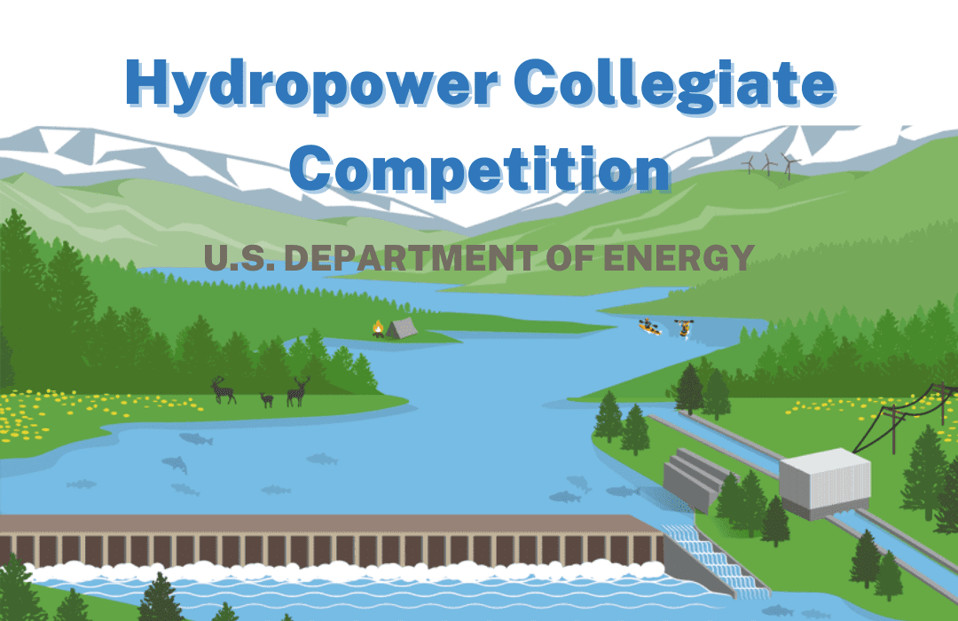


Project Description
Problem Statement: With the desire to remove US reliance on coal, nuclear, and fossil fuel driven energy while also taking advantage of potential energy in respect of water batteries through a closed-loop pumped storage hydropower system. This model will help to address the nations clean energy goals while preserving the environment and making use of untapped power.
Sponsor: US Department of Energy + Energy Club
Advisor/Client: Dr. Carson Pete
Fig. 1: Art for HCC Competition

Slide 3
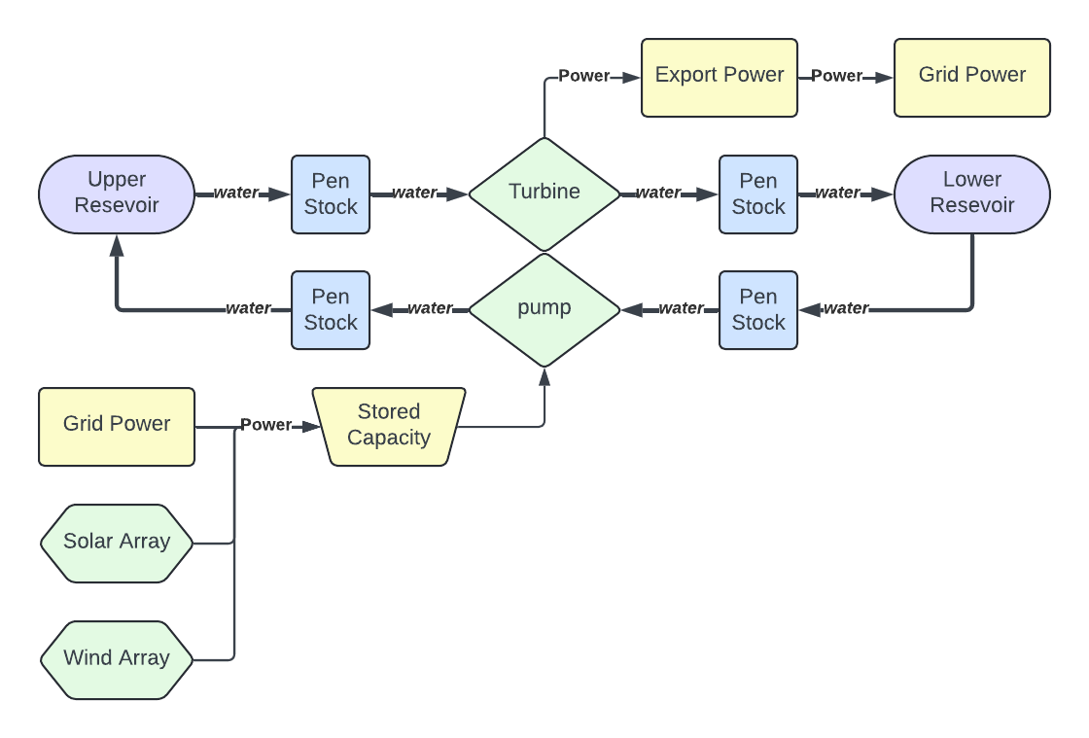
Functional Model
When power is needed, water flows down the pen stock and through a turbine; and when power is in excess, water is pumped back up.
The question is, when do you run the turbine or pump?
Fig. 2 - Functional Model of a simple, hydropower plant
Notes:
Main Topic: Rather than discussing the “what” of the model and how a dam works, explain how does this model help us better abstract the design problem and why did we even create it?
FROM CLIENT REQUIREMENTS
Helps us identify critical components for initial concept generation
STORE WATER (damn structure) – INTAKE – CONVERT TO ROT (turbine)

Slide 4
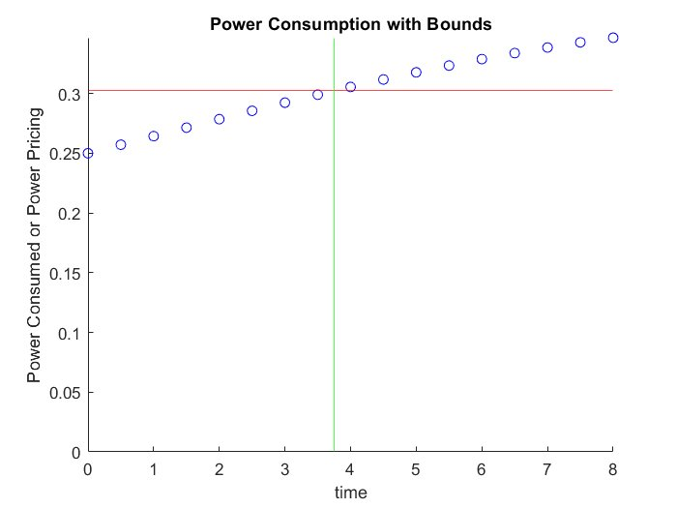
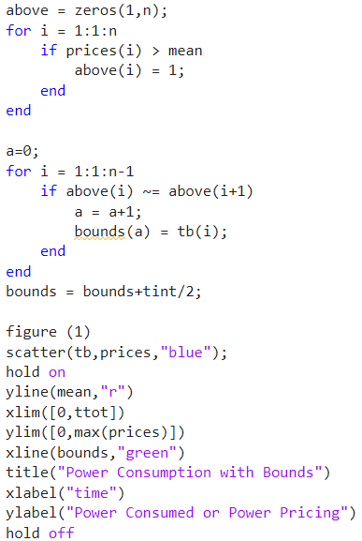
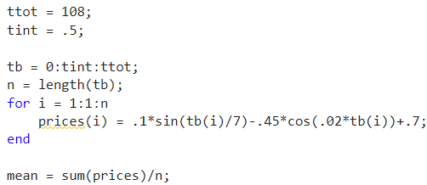
The Raw Code
Currently, the code takes a set of data points and outputs the boundaries of when power consumption is above or below average.
Can also be modified to find bounds above a set limit.
Figure 4: example of working code
Figure 5: code for example data set
Figure 6: current code

Slide 5
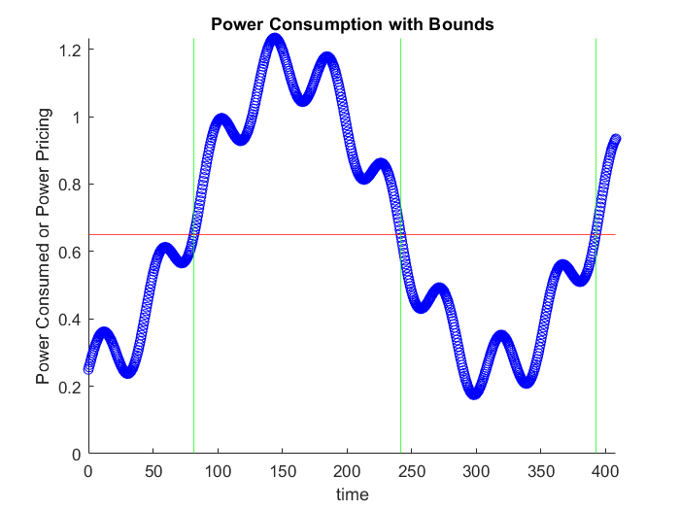
Code in Action Example
The code at present outputs bounds for starting and stopping, but needs to be expanded further
Get actual data for analysis
Add asymmetrical flow rate calcs
Calibrate for efficiency of the final design in power loss
Figure 7: Example Test data set with bounds

Slide 6
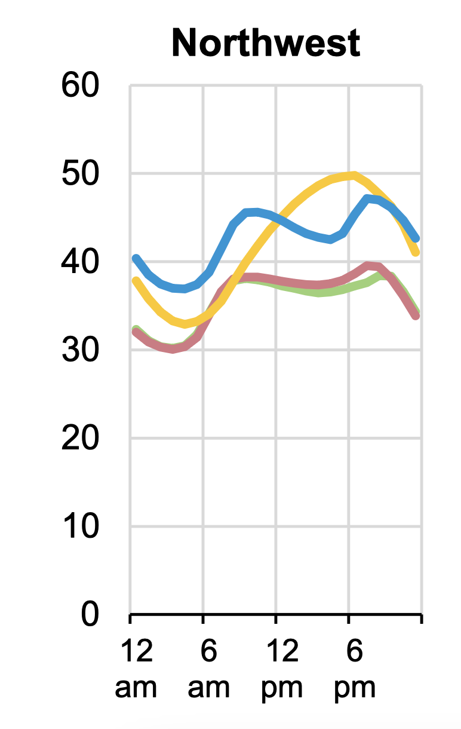
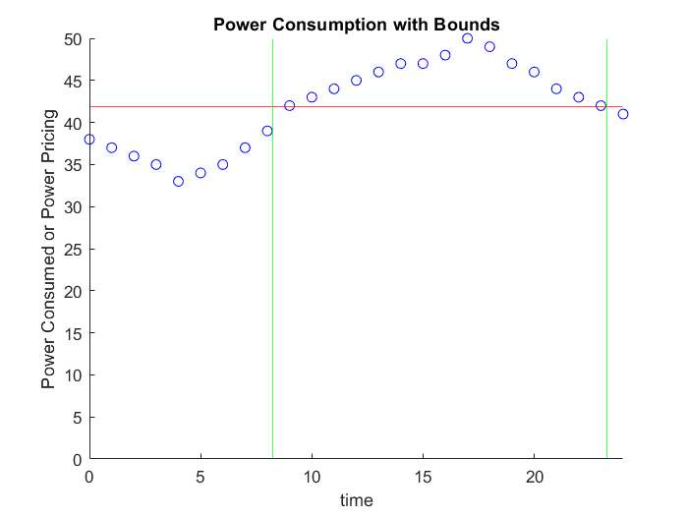
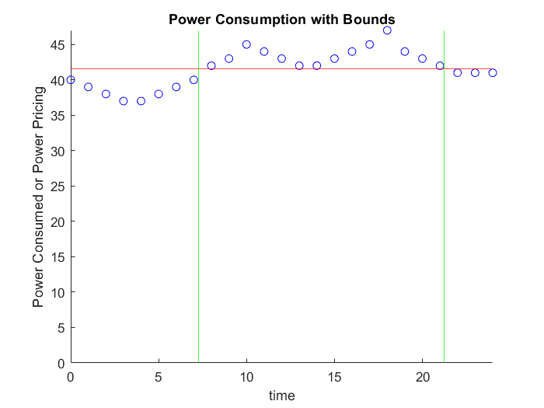
Rough Northwest Regional Data
This is a rough data set we got from a DOE website [1], and the data bounds that resulted from running the code for the summer and winter sets.
Figure 8: Summer Data
Figure 9: Winter Data
Figure 10: Power Data from the DOE

Slide 7
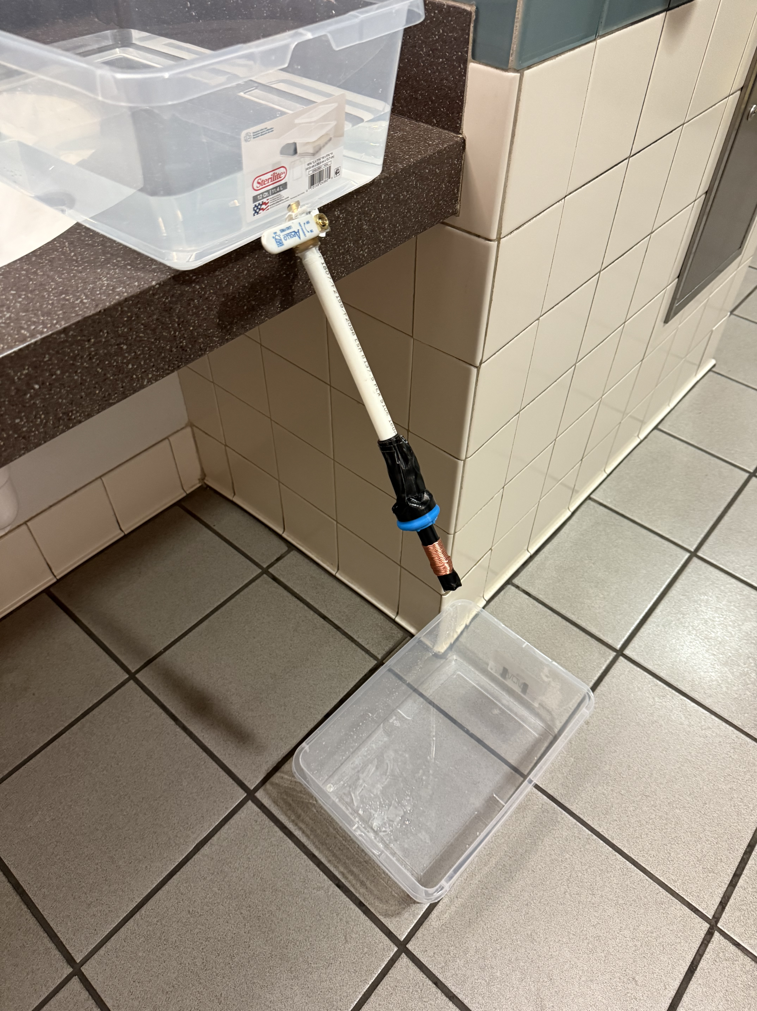
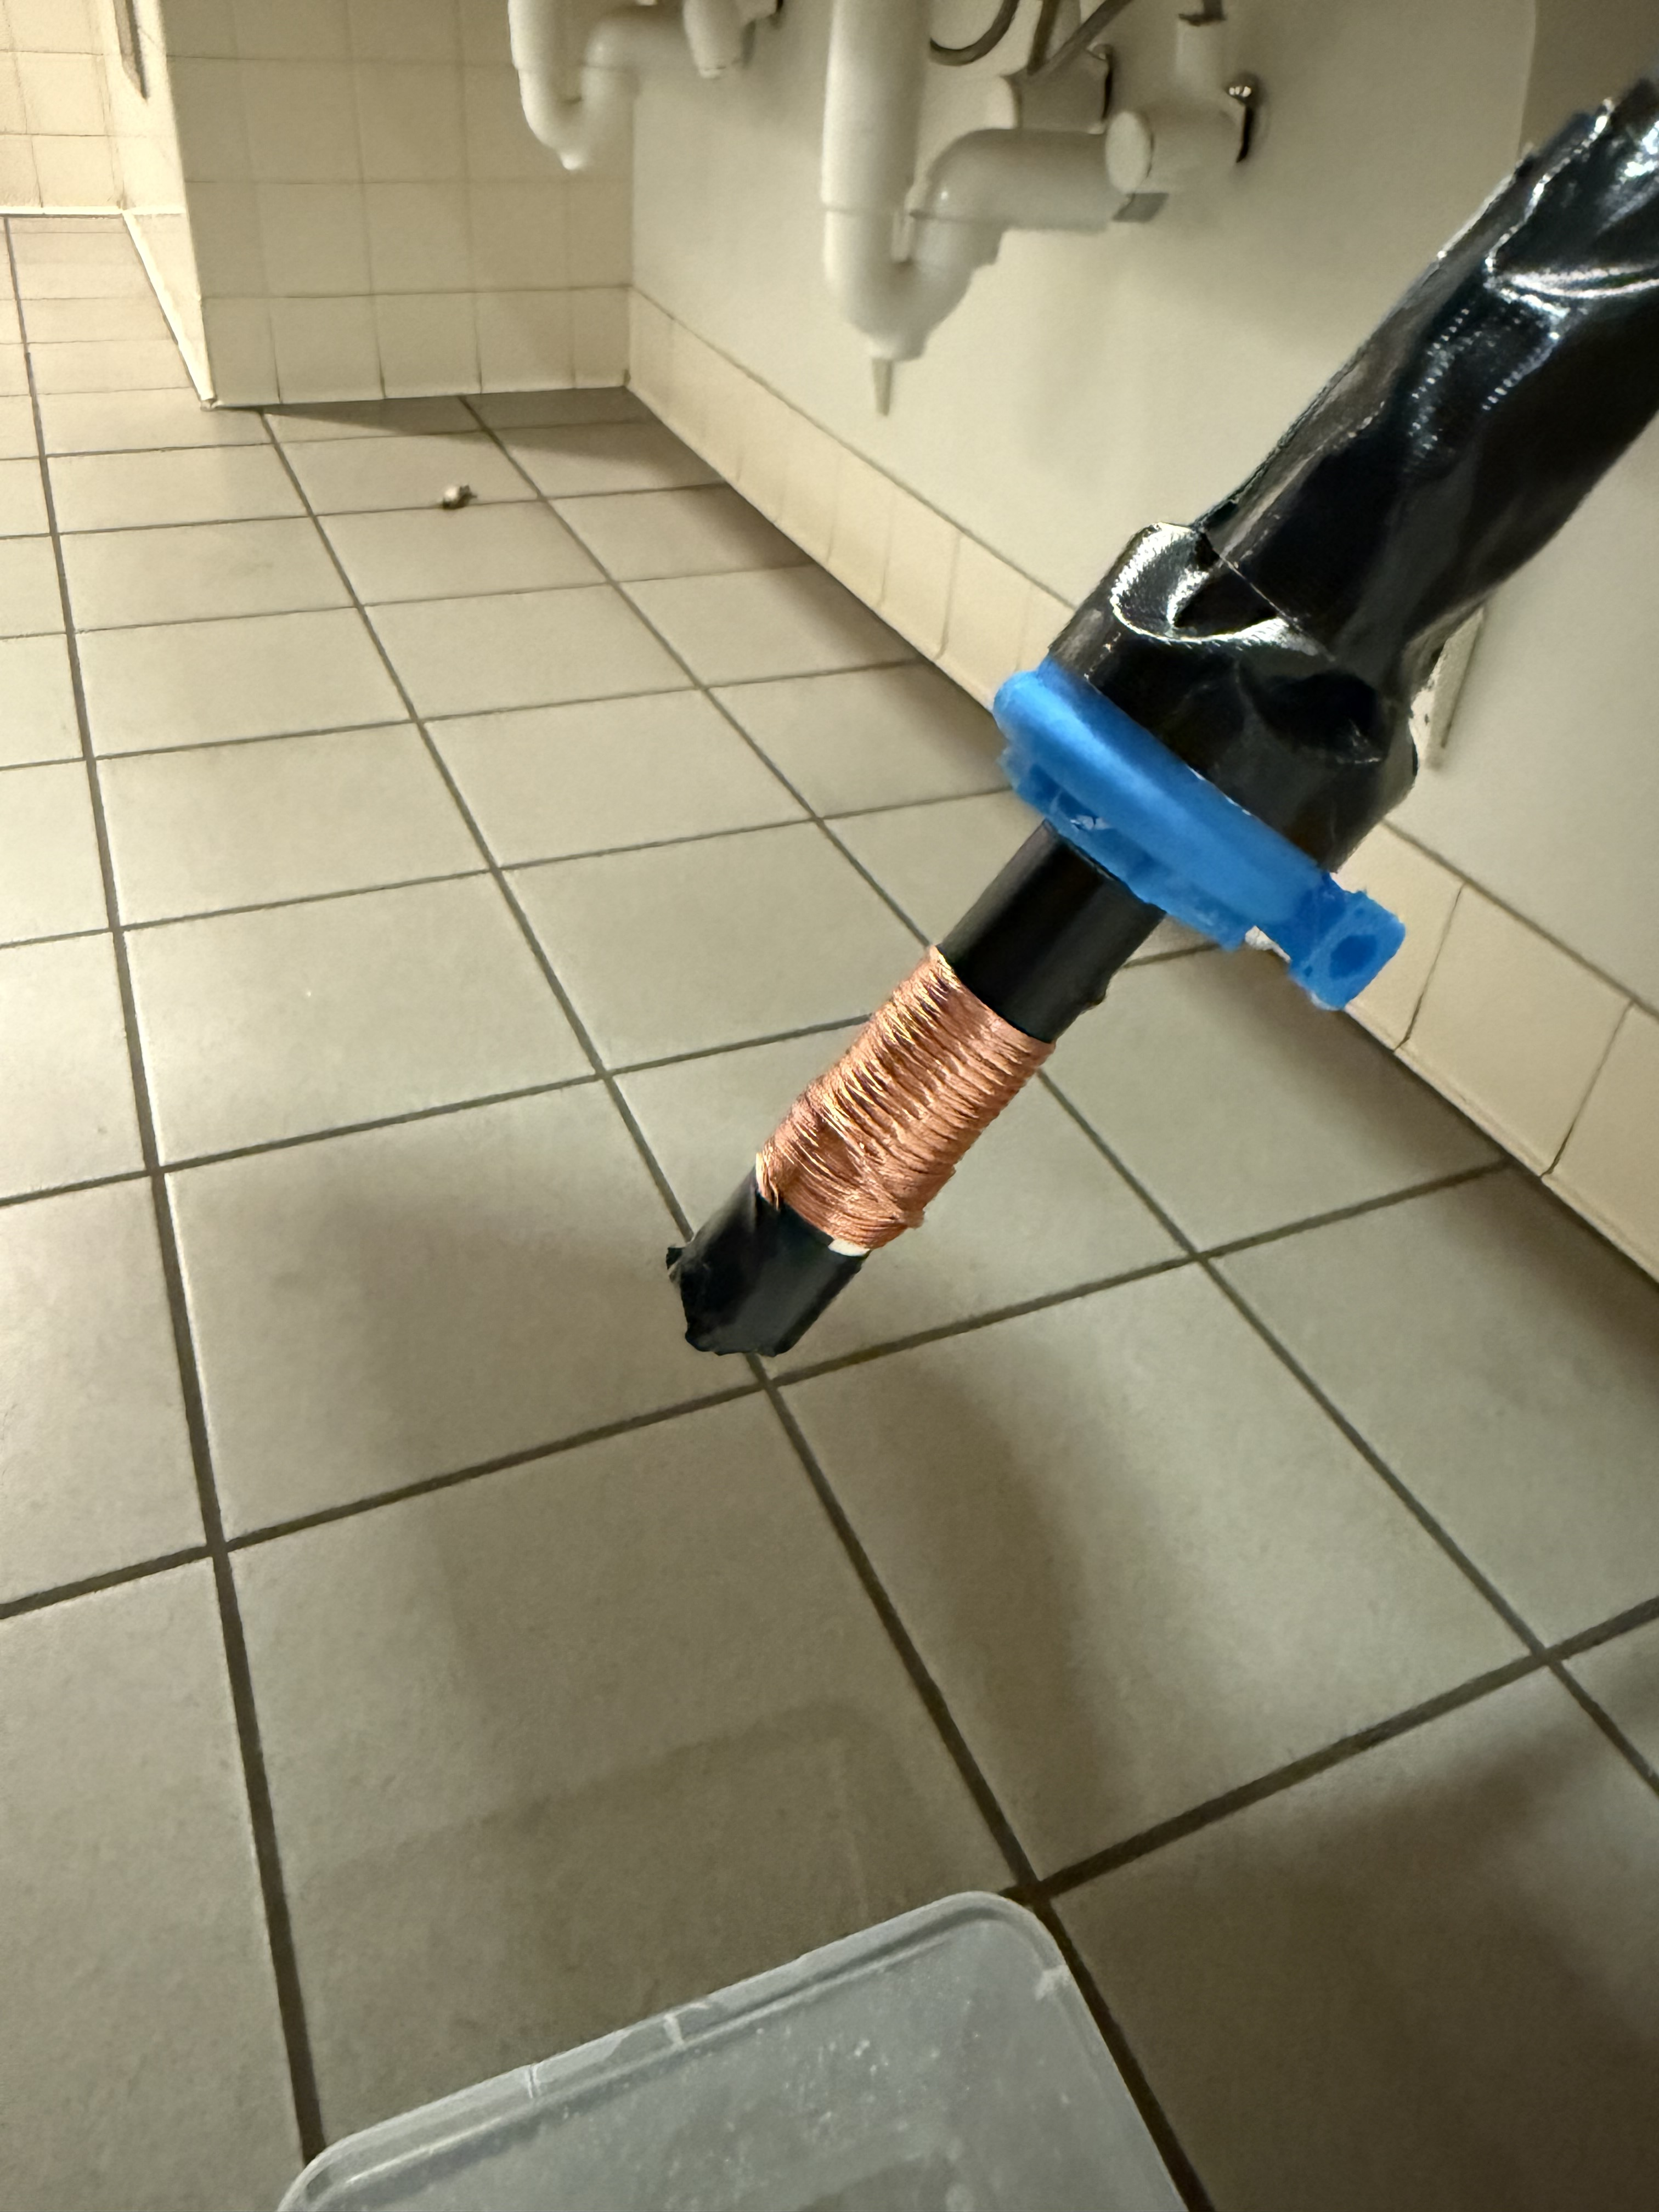
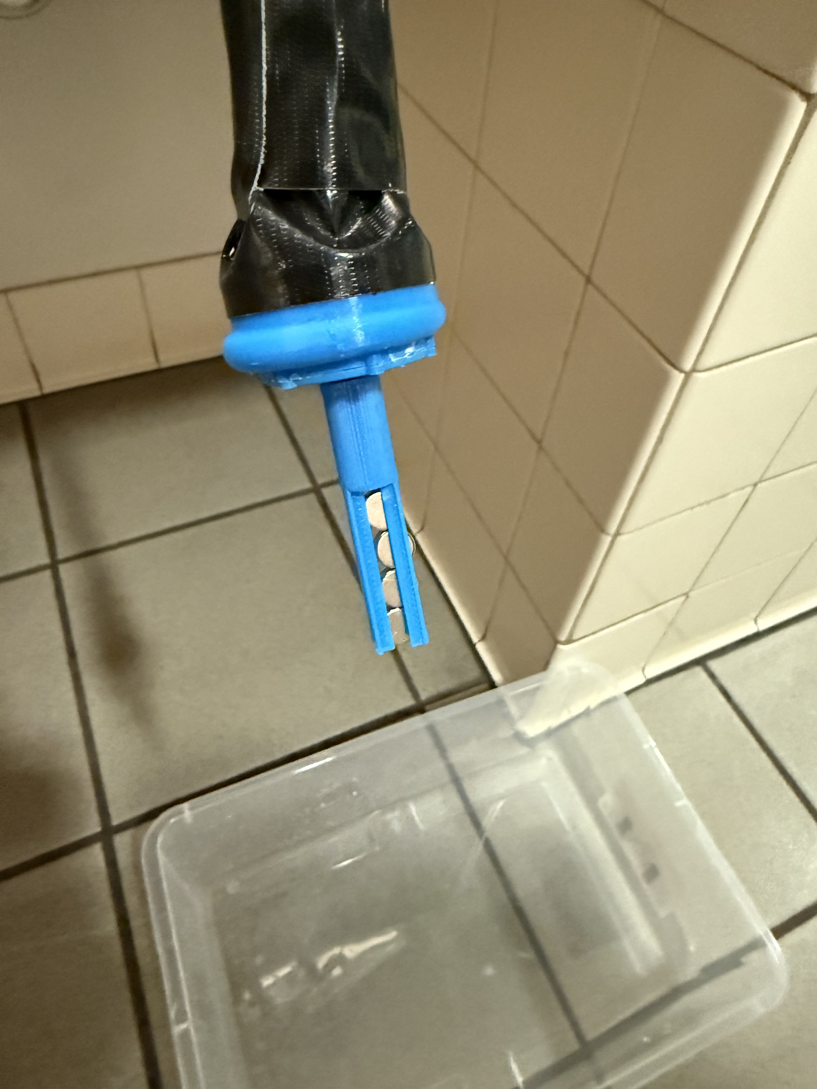
Physical Prototype

Slide 8

Physical Prototype
Question: What angle for reservoir/penstock connection works? What angle for penstock/turbine connection works?

Slide 9
Answers
Theoretical Prototype (1)
Physical Prototype (2)
For our methods we used Matlab and a department of energy source for the overall energy dataset for different months of the year.
The answer was our optimal hours of operation in figure 8 and 9
For future designs this prototype has informed us on when to run our turbine and when to pump and for future analysis we can input our new data sets for specific sites instead of just the northwest data.
Team members: Noah and Jennifer
For our methods we used 3D printing and store-bought items
The answer was that it did work but needed some adjustments to optimize our design.
With this new information we now know that we need a larger turbine, a wider penstock, a greater penstock angle, and a higher flow rate.
Team members: Benjamin and Robert
Note: this prototype will also be used as a basic model for our community connections challenge to be used for future events.

Slide 10
Thank You!

Slide 11
Sources
[1] "Today in Energy", U.S. Energy Information Administration. [Accessed Nov., 2024]. Avaliable: https://www.eia.gov/todayinenergy/detail.php?id=42915

